Slide 1
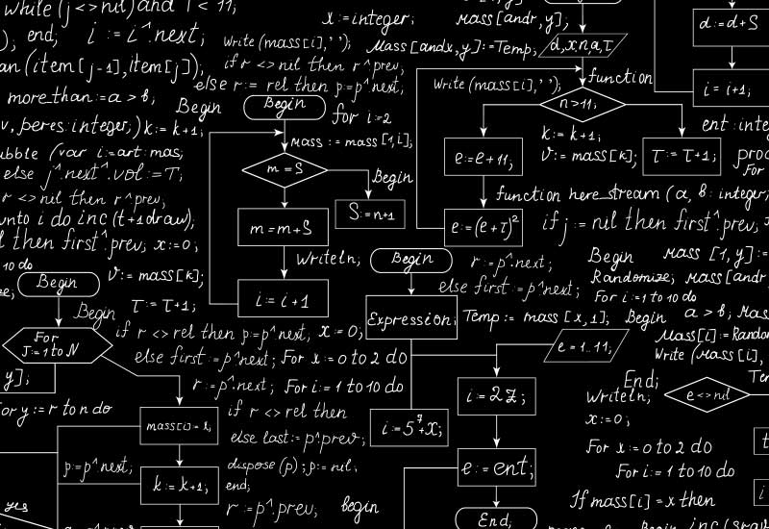
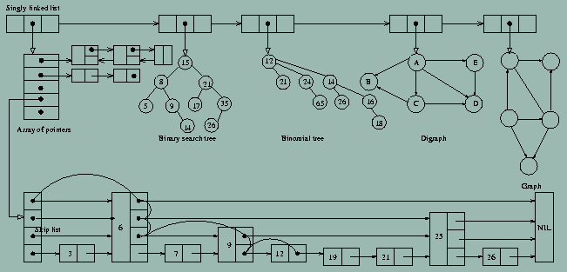



Why Data Structures?
Algorithms + Data Structures = Programs
-Niklaus Wirth
CLRS, Sections 2.1 – 2.2

Slide 2



Performance Bottleneck: Algorithm or Data Structure?
Will my program be able to solve a practical problem with large input?

Slide 3
Data Structures & Algorithms vs. Programming
All of you have programmed and have already been exposed to algorithms and data structure.
Perhaps you didn't see them as separate entities
Perhaps you saw data structures as simple programming constructs (provided by Java libraries).
However, data structures are quite distinct from algorithms, and very important in their own right.

Slide 4
Interplay of Data Structures and Algorithms
Data Structure Example Applications:
How does Google quickly find web pages that contain a search term?
What’s the fastest way to broadcast a message to a network of computers?
How can a subsequence of DNA be quickly found in a genome?
How does your operating system track which memory (disk or RAM) is free?
In the game Call of Duty, how can the computer determine which of the scenes should be visible?

Slide 5
Some Famous Algorithms
Constructions of Euclid
Newton's Root Finding
Fast Fourier Transform
Compression (Huffman, Lempel-Ziv, GIF, MPEG)
DES, RSA Encryption
Simplex Algorithm for Linear Programming
Shortest Path Algorithms (Dijkstra, Bellman-Ford)
Error Correcting Codes (CDs, DVDs)
TCP Congestion Control, IP Routing
Pattern matching (Genomics)
Page Rank

Slide 6
Design and Analysis
Foundations of Algorithm and Data Structure Analysis:
Data Structures (CS 321):
How to efficiently store, access, manage data?
How data structures effect algorithm’s performance?
Algorithm Design and Analysis (CS 421):
How to predict an algorithm’s performance?
How well an algorithm scales up?
How to compare different algorithms for a problem?

Slide 7
Example: The Sorting Problem
INPUT: A sequence of n numbers A = (a₁,a₂,…,a_{n})
OUTPUT: A permutation A’=(a’₁,a’₂,…,a’_{n}) of the input sequence such that a’₁ ≤ a’₂ ≤ … ≤ a’_{n}
Example:
Input sequence: A = [ 6, 5, 3, 1, 8, 7, 2, 4]
An instance of the problem
Output sequence: A’ = [1, 2, 3, 4, 5, 6, 7, 8]

Slide 8
Insertion Sort: Example
6 5 3 1 8 7 2 4

Slide 9
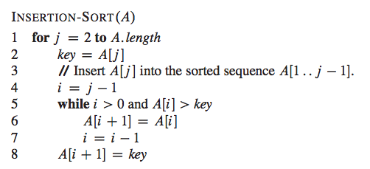
Insertion Sort: Algorithm

Slide 10
Algorithms Analysis
Input size: size of the input
For the sorting problem, it is the number of items to be sorted, n.
For the integer multiplication problem, it is the total number of bits needed to represent the integers in input, b.
For graph problems, it is the number of vertices |V| and the number of edges |E|.

Slide 11
Algorithms Analysis
Running time: number of primitive operations (or steps) executed by the algorithm.
It is a function of the input size.

Slide 12
Insertion Sort Running Time
The cost of each step is constant

Slide 13
Insertion Sort Running Time
The for loop is executed (n – 1) times

Slide 14
Insertion Sort Running Time
The while loop is executed t_{j} times
- t_{j} varies with j and the sequence of items to be sorted

Slide 15
Insertion Sort Running Time
The input size is n (number of items).
The running time depends on the type of input we have:
Best case: the sequence is already sorted.
Worst case: the sequence is in reverse sorted order.

Slide 16
Insertion Sort Running Time
Best case: the sequence is already sorted
the for loop is executed n times
the while loop is executed t_{j} = 1 time, for all j = 2, …, n
The running time in this case is a linear function of n
O(n)

Slide 17

Insertion Sort Running Time
Worst case: the sequence is in reverse sorted order
the for loop is executed n times
for each j = 2, …, n compare A[j] with each element of the sorted sub-sequence A[1… j -1], then the while loop is executed t_{i} = j times
The running time of insertion sort is which is a quadratic function of n.
O(n²)

Slide 18
Insertion Sort Running Time
In general, we are interested in the worst-case running time.
It gives us an upper bound on the running time for any input.
Average case: But average case is often as bad as the worst case
For insertion sort:
Do j / 2 comparisons in the while loop, so t_{i} = j / 2 for each j = 2, …, n
So, the running time is again a quadratic function of n – O(n²)

